Slide 1
Volume of composite Prisms

Slide 2
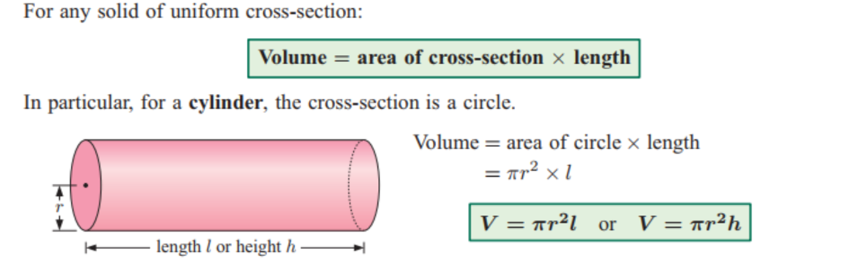

Topic: Volume
24
7
30
EQ: How do I apply the formula to find the volume of a prism
What is the general formula to find volume?
The general formula for ALL prisms is
$$Volume=Face Area×Depth$$

Slide 3
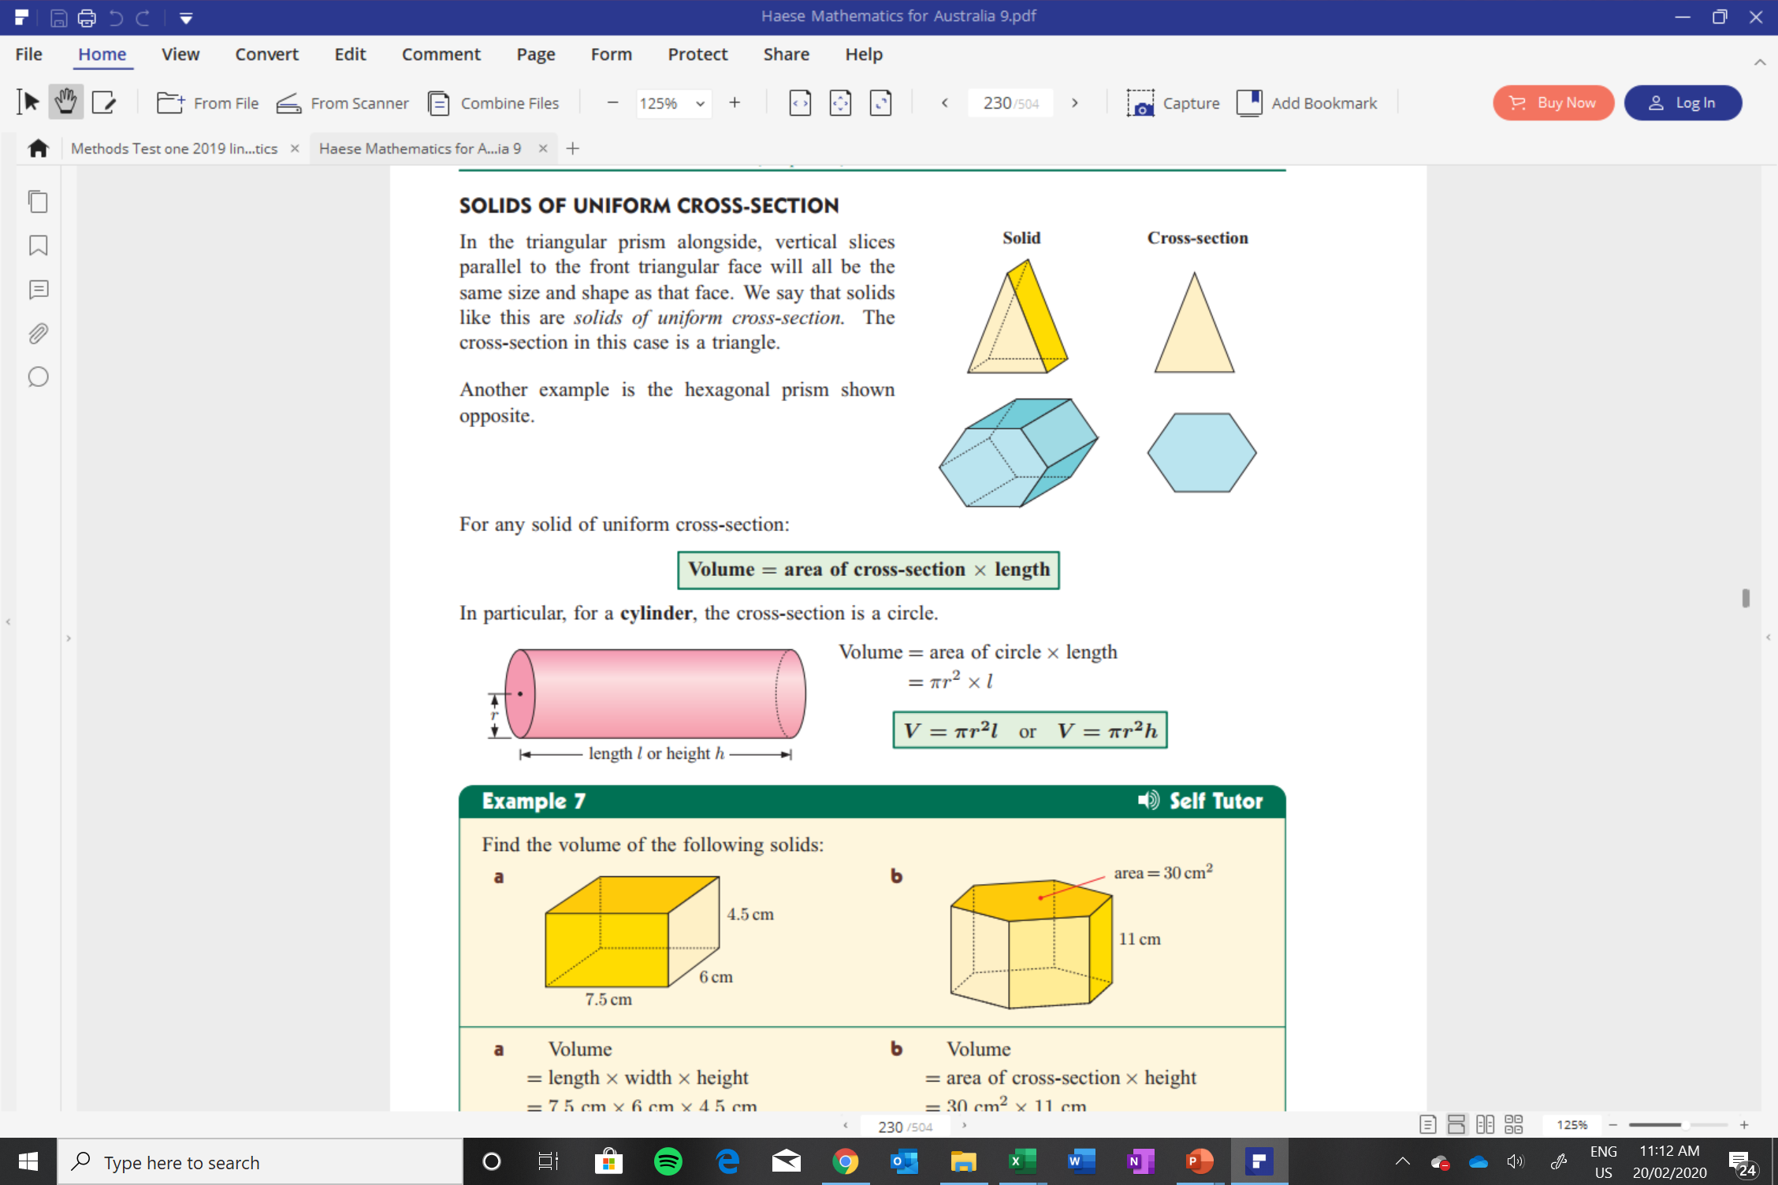

Slide 4
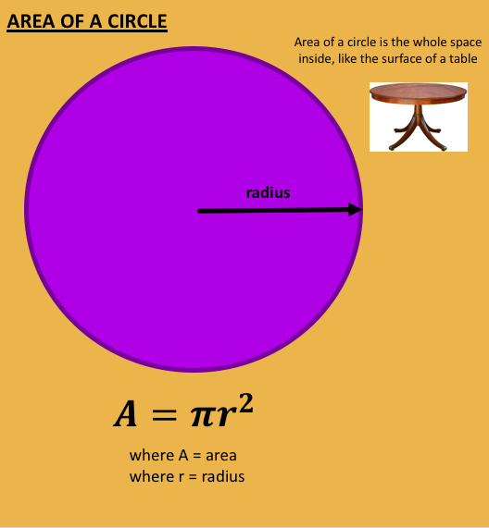
Work question on board and in books

Slide 5
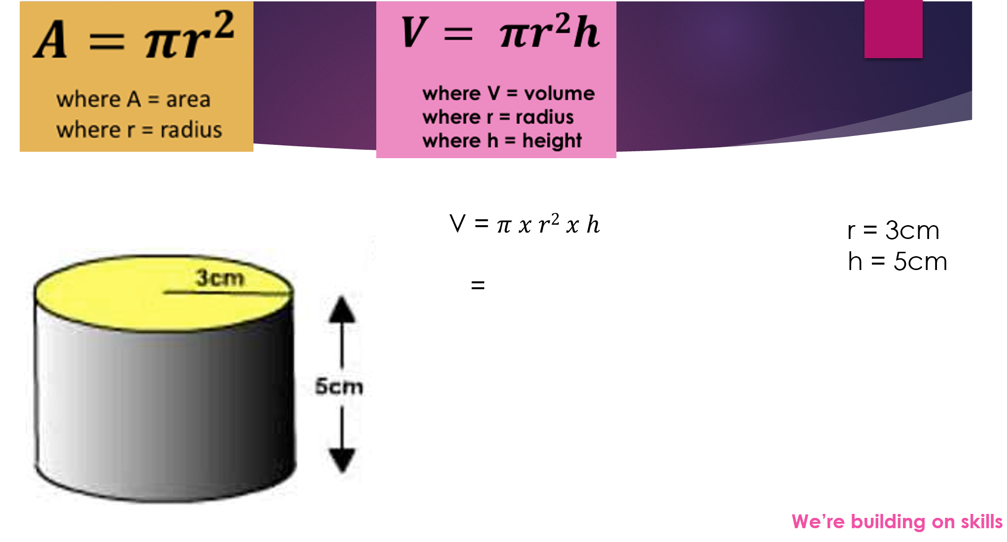
Topic: Volume
24
7
30
EQ: How do I apply the formula to find the volume of a composite prism

Slide 6
Formulae for Spheres and Cylinders
A cylinder is also a prism
Therefore
= area of cross-section x vertical height
4πr³
3
Volume of
A sphere
r
=
Surface Area
= 4πr²

Slide 7
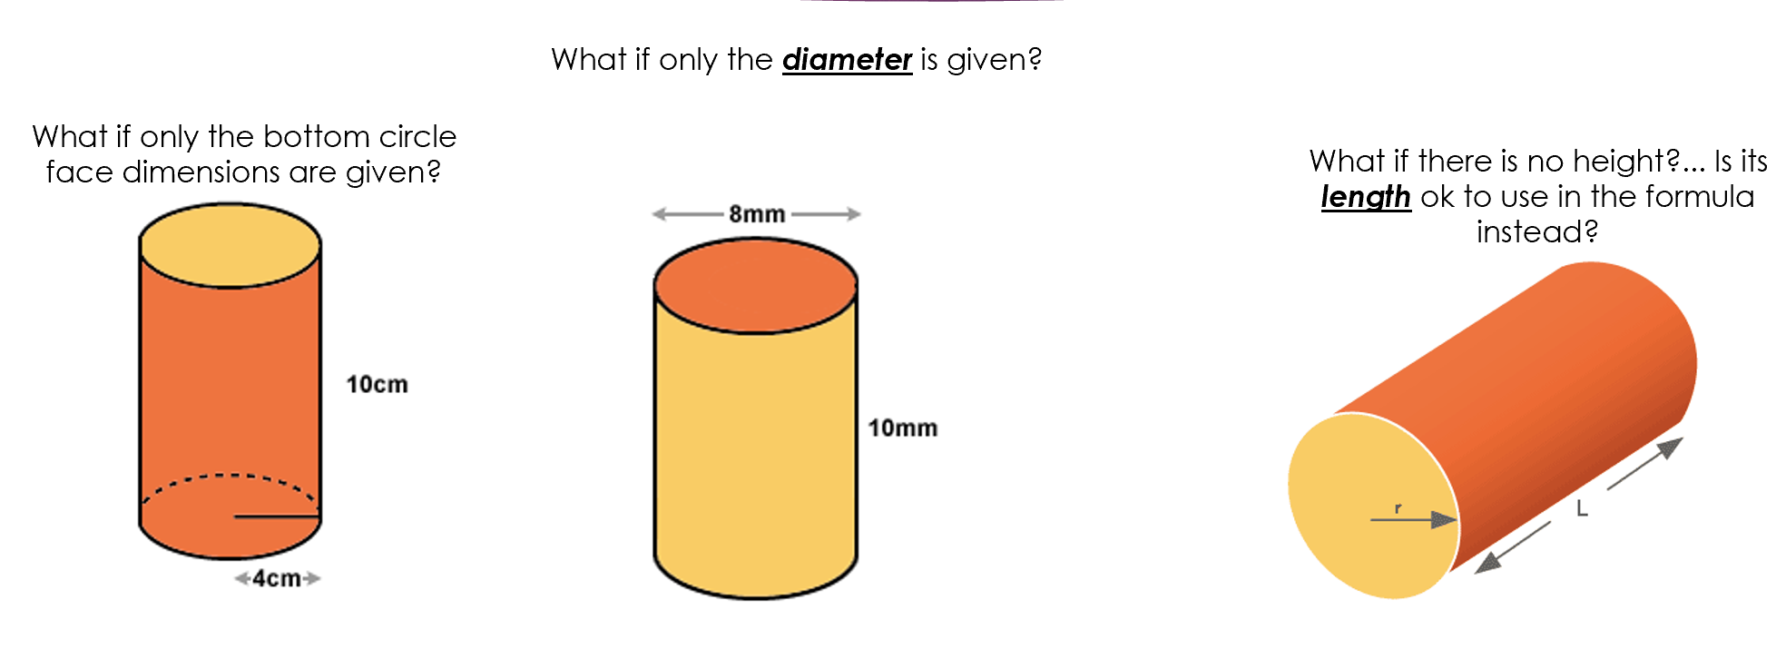
Topic: Volume
24
7
30
EQ: How do I apply the formula to find the volume of a composite prism

Slide 8
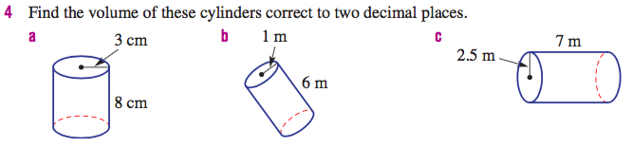
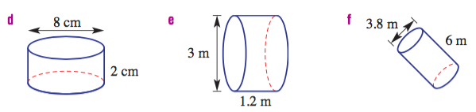
Ex. 1

Slide 9
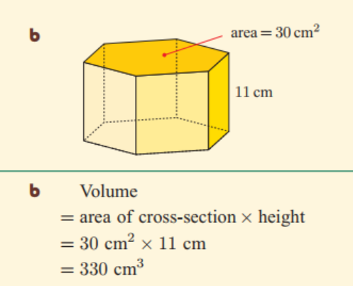
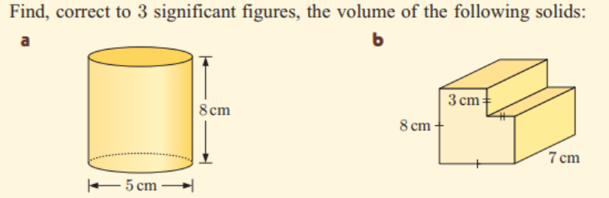
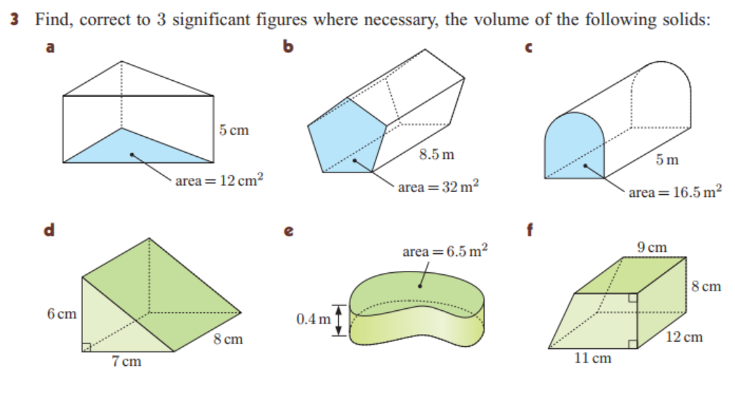

Slide 10
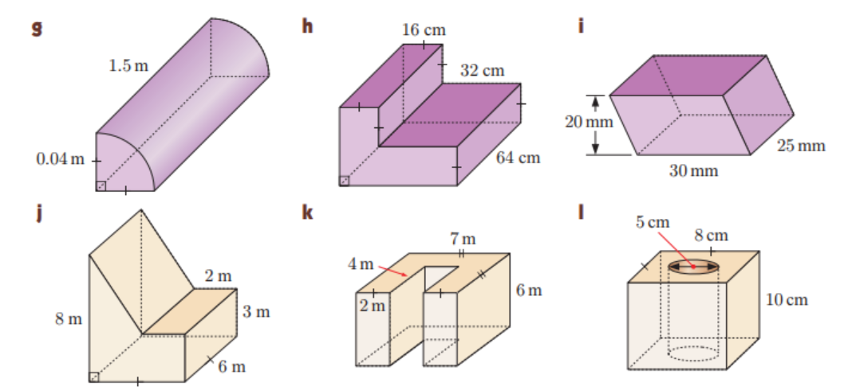

Slide 11

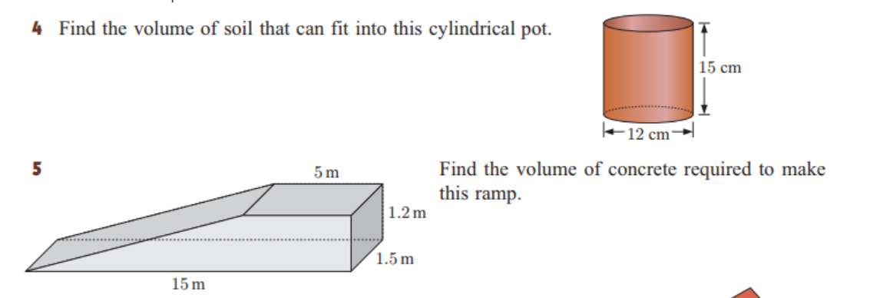

Slide 12
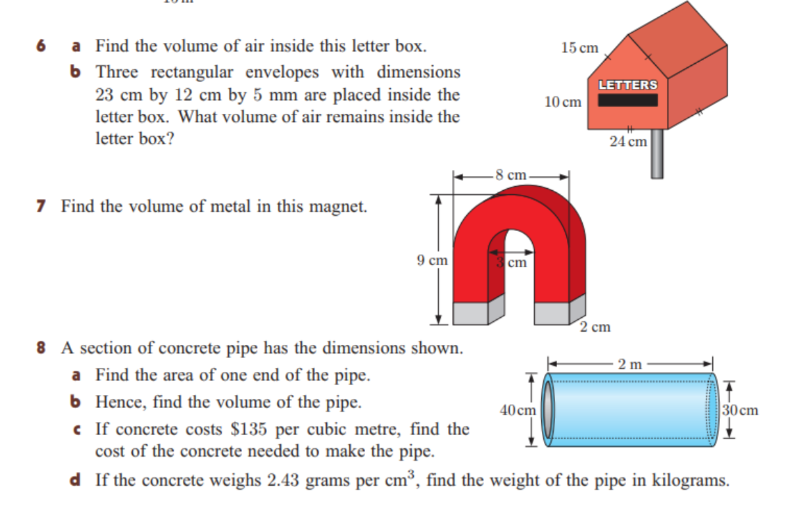

Slide 13
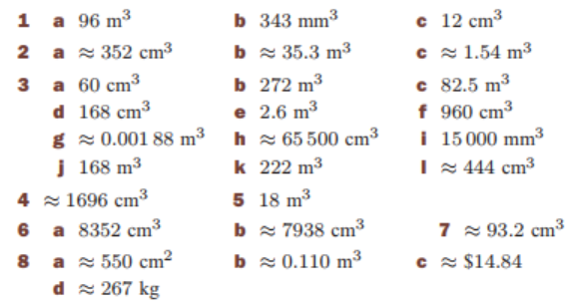
Solutions:

